Slide 1
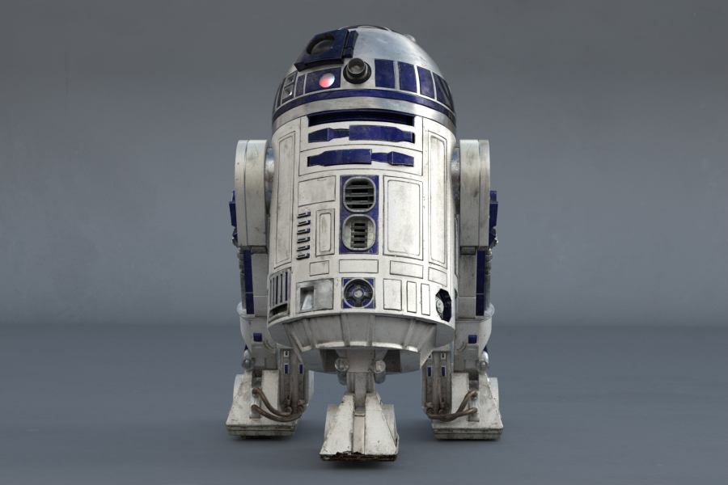
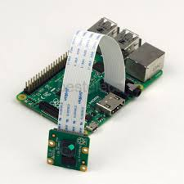
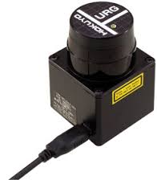
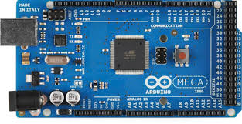
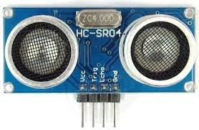
Robotics: R2-D2
Purpose: Build an R2-D2 Astromech Droid
Scenario: Design, build, and deliver a robot capable of safe, independent operation. The team shall architect a complete hardware and software solution using a modern robotic principles. Update power, safety, and control systems for increased utility. Integrate sensors and develop software for human/robot interaction.
Sponsor: DFEC
Mentor: Maj Walchko
R2-D2 Key Sensors/Electronics:
LIDAR
Research Areas and Experiments
Autonomous and Remotely Operated Systems
Guidance, Navigation, and Controls
Computer Vision
Speech Recognition
Linux Operating System
Embedded Hardware and Software Systems
Electronic and Power System Design
Sensor Calibration and Fusion
Testing and Integration
Raspberry Pi and Cameras
Arduino Mega
Ultrasonic

Slide 2
Topics
Navigation
Sensor fusion
IMU integration
INS development
Vision
Color tracking
People id/tracking
Obstacle detection
Visual odometry
Human/Machine
Command recognition
Remote operation
Power system redesign
Simplify and reduce SWaP
Board design
Hardware mods (?)
Autonomy
Personality
System engineering
Document HW/SW design and interfaces
Risk, trades, timeline
User manual
Safety (PESHE)
For both building, maintaining, and ops

